Slide 1
Programming on microcontrollers and single board computers
By: Ayesha Ahmed
Course: STEM ENG 200

Slide 2
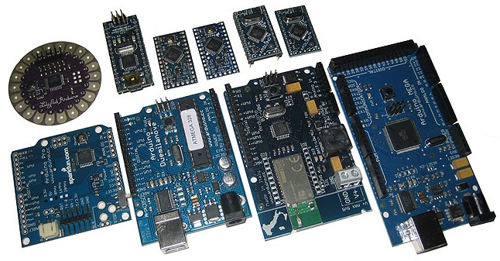
Arduino

Slide 3
The Arduino
Cost is about $25 to $35.
Arduino is more suited to building and learning about electronics.
Raspberry Pi has better networking and multimedia capabilities

Slide 4
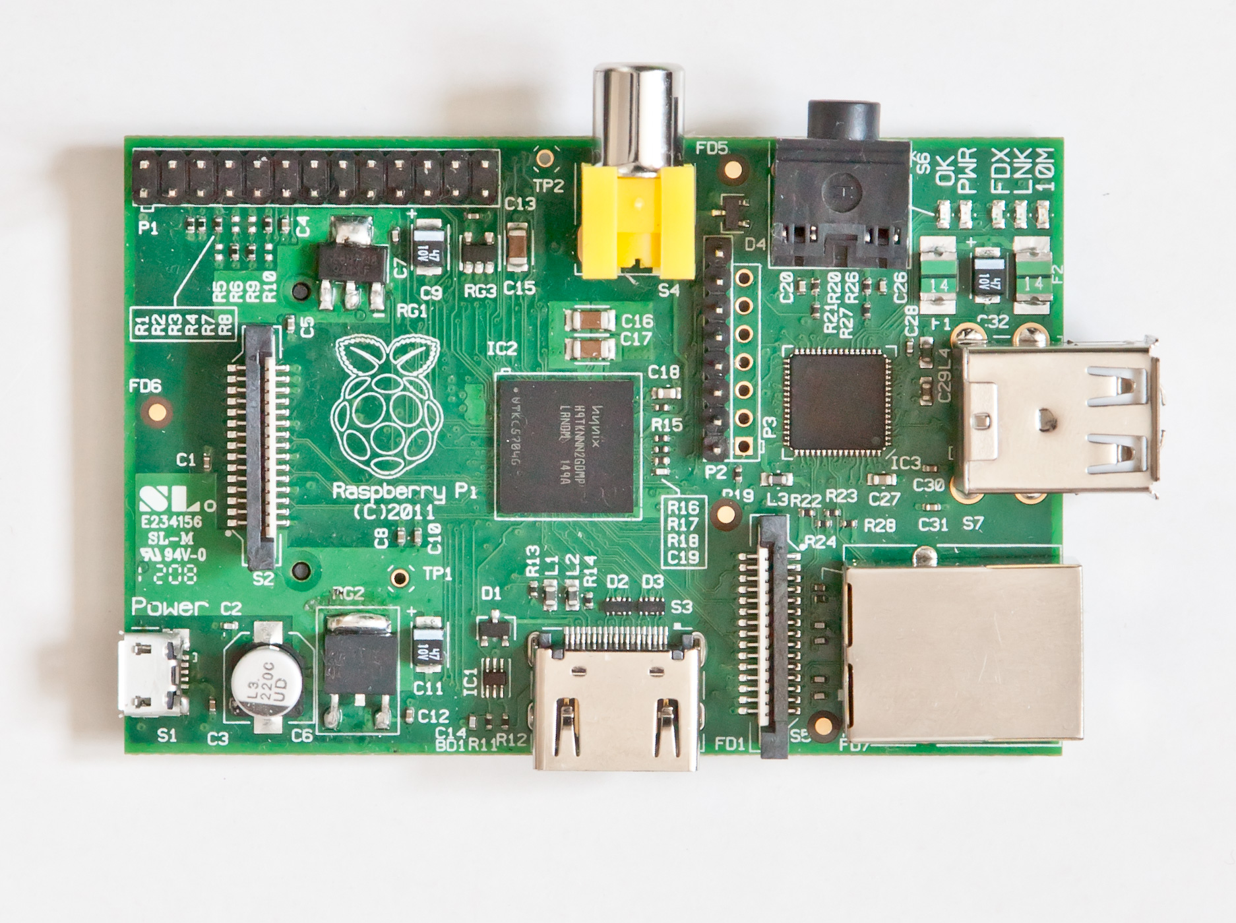

Slide 5
Purpose
Single board, low cost computer
Cost of $35 to $45
Designed for educational use to teach programming.

Slide 6
Technical Description
Single board computer
700 Mhz ARM CPU
512M of RAM
Build in support video
Storage on an SD card

Slide 7
Software
Designed to run Linux
“Official” version is Raspbian
Based on Debian Wheezy distribution
Other versions of Linux are available
http://www.raspberrypi.org/

Slide 8
Raspberry Pi Connectors
(2) USB connectors
Ethernet connector
HDMI for video
5-volt microUSB power receptacle
20-pin I/O ports
Audio & video ports
Dedicated port for video cam

Slide 10
What Can I Use it for?
Learn programming
Python & Scratch included
Used for various electronics projects
Networking applications
Router, server, etc.
Motor Control
Robotics

Slide 11
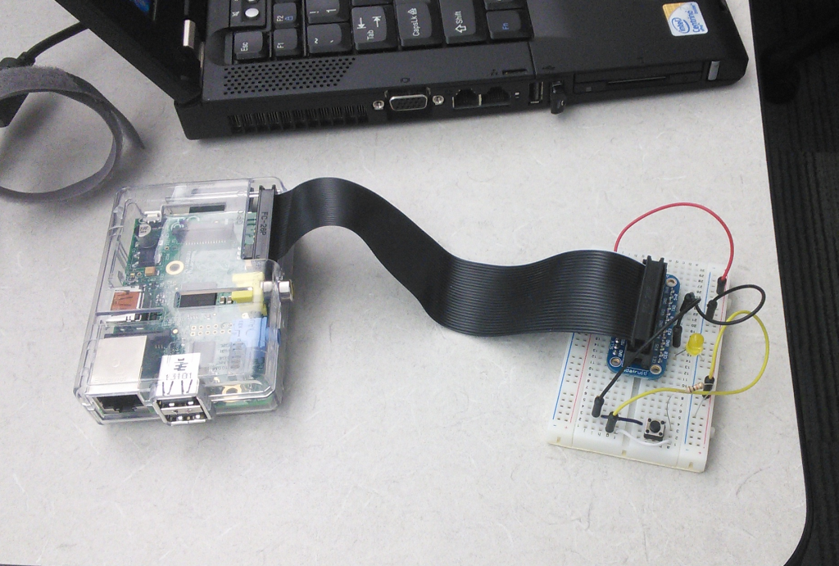
Example

Slide 12
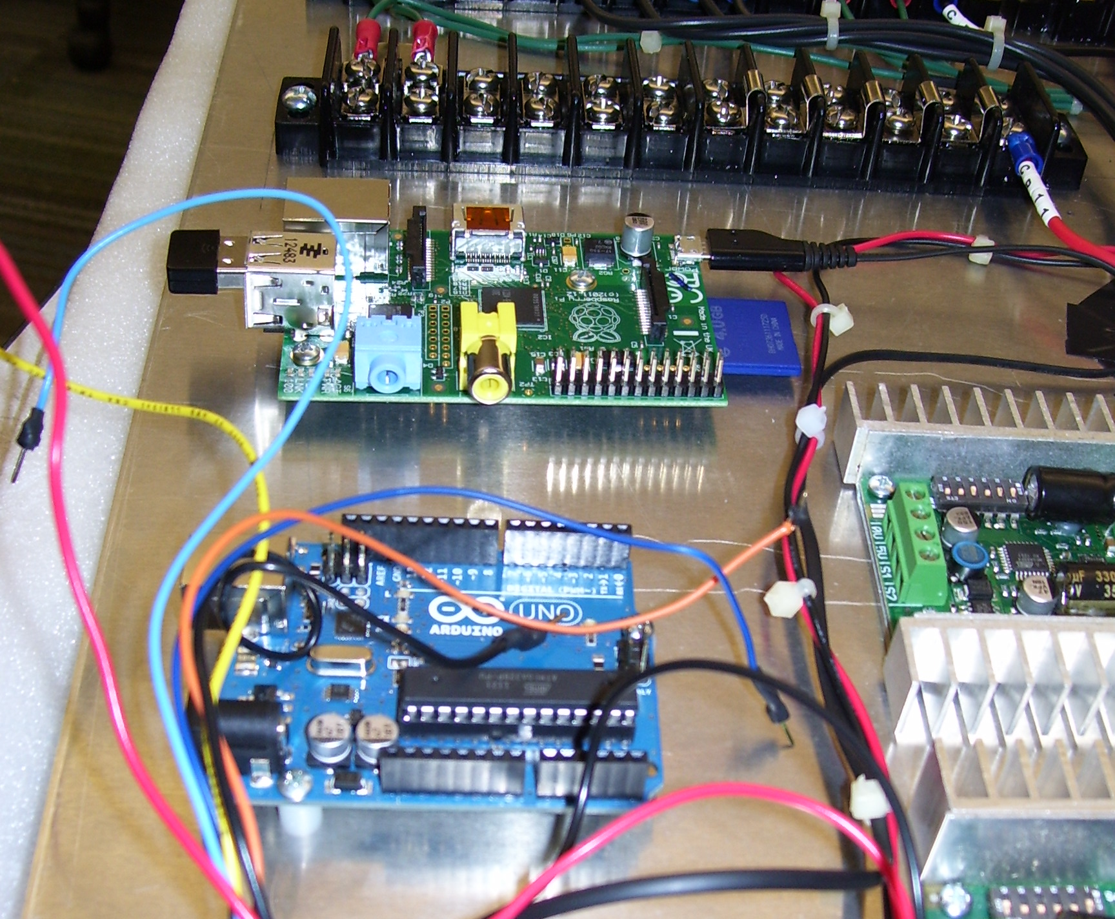
Oakton’s 2013 Lunabot

Slide 13
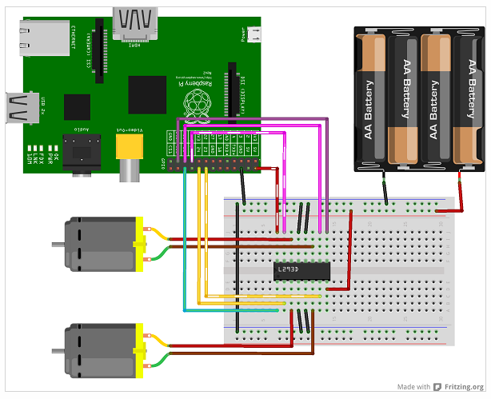

Slide 14
Future Plans
Work with more complex robots.
Learn how to send continuous commands through controller to robot with wired and wireless connection.
Path planning for autonomous functioning with use of sensors.

